Slide 1



Functional genomics analysis using Pathways, Annotated Gene Lists and Gene Signatures Electronic Repository (PAGER)
Presenter: Zongliang Yue, Ph.D.
Mentor: Jake Y. Chen, Ph.D.
Institute: UAB Informatics Institute

Slide 2
Published works
Database
Zongliang Yue#, Eric Zhang#, Clark Xu, Sunny Khurana, Nishant Batra, Son Dang, and Jake Y. Chen* (2021) PAGER-CoV: A Pathway, Annotated-list and Gene-signature Electronic Repository for Coronavirus Diseases Studies. Nucleic Acids Research, Volume 49, Issue D1, Pages D589–D599, https://doi.org/10.1093/nar/gkaa1094
Zongliang Yue, Qi Zheng, Michael T Neylon, Minjae Yoo, Jimin Shin, Zhiying Zhao, Aik Choon Tan, Jake Y Chen, (2018) PAGER 2.0: an update to the pathway, annotated-list and gene-signature electronic repository for Human Network Biology, Nucleic Acids Research, Volume 46, Issue D1, Pages D668–D676,https://doi.org/10.1093/nar/gkx1040
Zongliang Yue, Madhura M. Kshirsagar, Thanh Nguyen, Chayaporn Suphavilai, Michael T. Neylon, Liugen Zhu, Timothy Ratliff, Jake Y. Chen, (2015) PAGER: constructing PAGs and new PAG–PAG relationships for network biology, Bioinformatics, Volume 31, Issue 12,, Pages i250–i257,https://doi.org/10.1093/bioinformatics/btv265
Method & Application
Zongliang Yue, Radomir Slominski, Samuel Bharti, Jake Y Chen* (2022) PAGER Web APP: An interactive, online gene set and network interpretation tool for functional genomics, Frontiers in Genetics, https://doi.org/10.3389/fgene.2022.820361
Zongliang Yue, Michael T. Neylon, Thanh Nguyen, Timothy Ratliff, and Jake Y. Chen* (2017) "Super gene set" causal relationship discovery from functional genomics data, IEEE Transactions on Computational Biology and Bioinformatics, DOI: 10.1109/TCBB.2018.2858755
Jake Y. Chen*, Zongliang Yue, Michael T. Neylon, Thanh Nguyen, Nafisa Bulsara, Itika Arora, and Timothy Ratliff (2016) Towards constructing "Super Gene Sets" regulatory networks. Proceeding of the 2016 international Conference on Bioinformatics, & Biomedicine, Shenzhen, China, doi:10.1109/BIBM.2016.7822534
Chayaporn Suphavilai, Liugen Zhu, and Jake Y. Chen* (2015) A method for developing regulatory gene set networks to characterize complex biological systems. BMC Genomics, Vol.16, Suppl.11, S4
Chayaporn Suphavilai, Liugen Zhu, and Jake Y. Chen* (2014) Constructing regulatory gene set networks to reveal novel insights into biological systems. Vol.10, Suppl.11, S5.

Slide 3
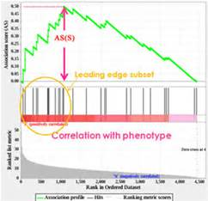
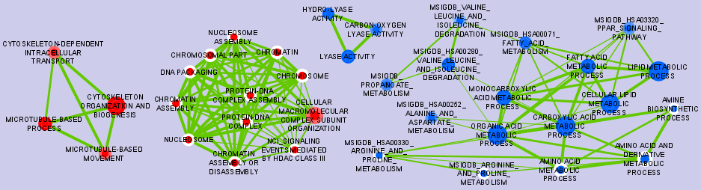
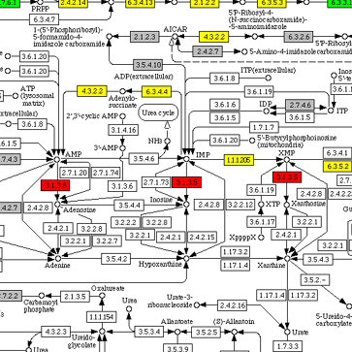
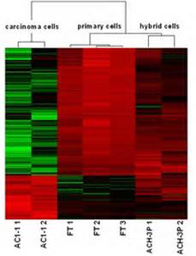
Integrative Gene-set, Network, and Pathway Analysis (GNPA)
Upstream Analysis
Integrative Omics Analysis
Downstream Analysis
RNA-SEQ
Format
Conversation
Data Extraction
Noise Reduction
Statistical Analysis
Biological Data Analysis
Ranking & Hypothesis Generation
Wet Lab Validation
Publication & Sharing
Exome
Extension of sequencing pipeline
Automated,
Mature, CPU/Disk intensive
Time-consuming
Many tools
Specialists required
Immature
Chip-seq
Gene set analysis
Network Analysis
Pathway analysis
Clustering
Can we characterize large Omics data sets in their complex biomolecular systems context, while performing integrated GNPA to improve biomedical discovery potential?

Slide 4
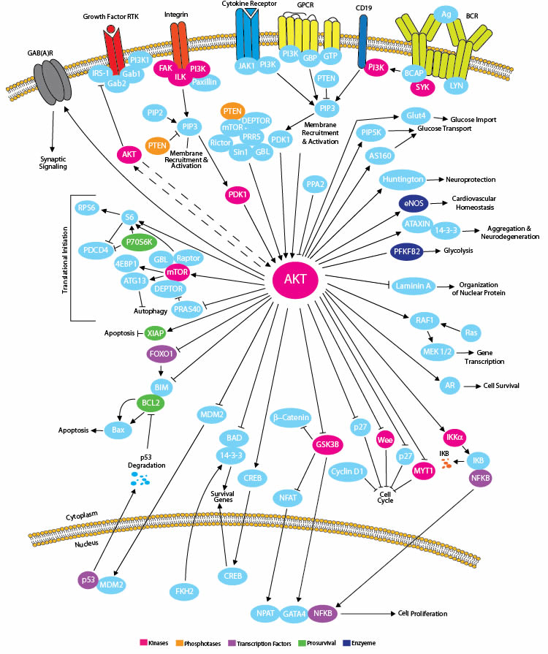
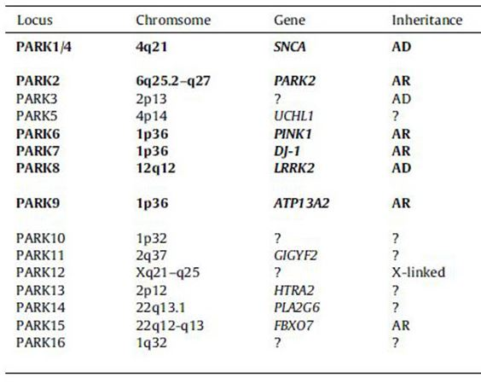
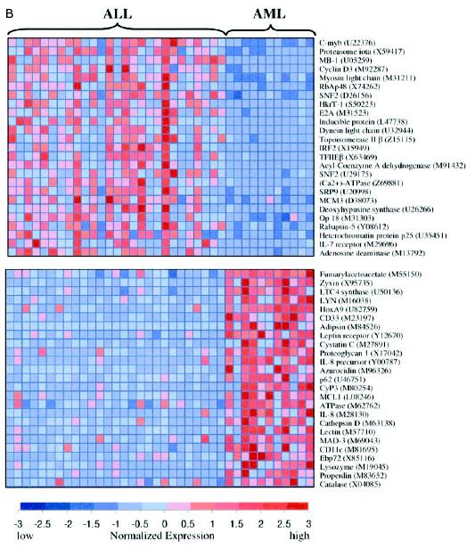
PAG to represent a “Super Gene Set”
It is a new data representation concept called PAG to support integrative GNPA
Each PAG = a set of genes + curation
Optional information: weights, structure, data links, …
Pathways
Annotated lists
Gene signatures
From RNA-seq, microarrays, proteomics, …
From RNA-seq, microarrays, proteomics, …
From RNA-seq, microarrays, proteomics, …

Slide 5
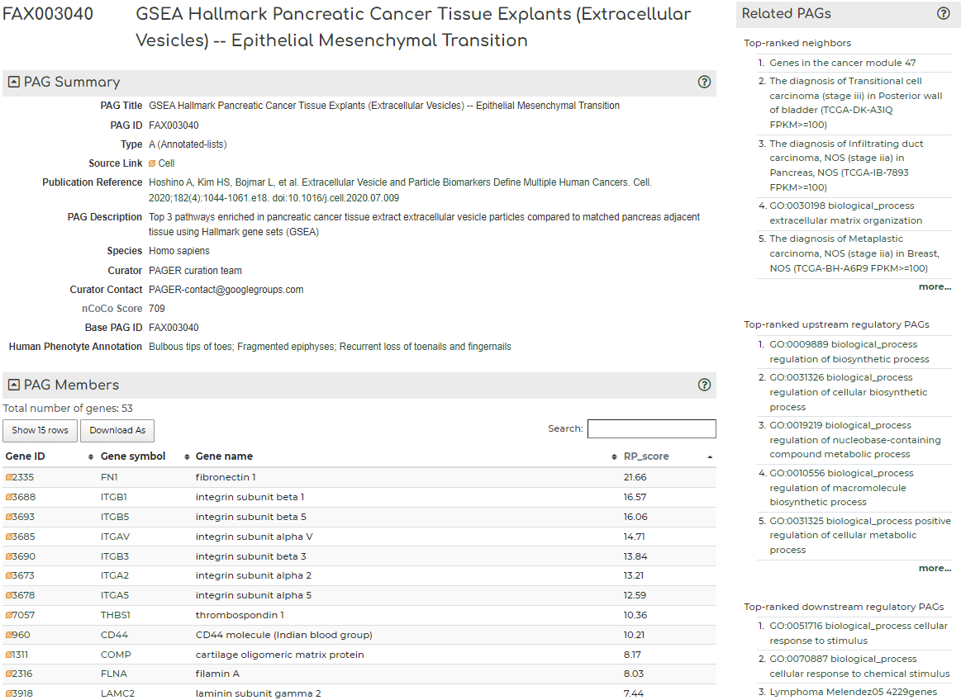
An example PAG: “FAX003040”
Functional genomics
No interactions
Curated from literature
http://discovery.informatics.uab.edu/PAGER/index.php/geneset/view/FAX003040

Slide 6
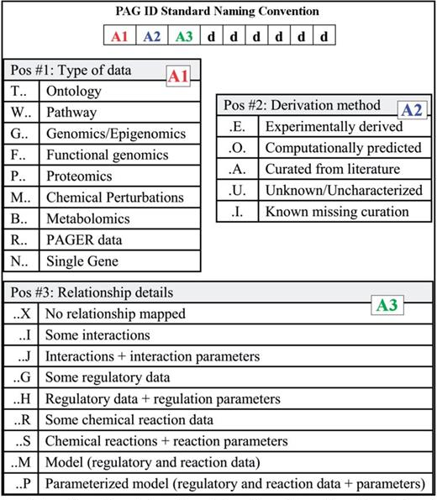
PAG naming Standard
Yue et al (2015) Bioinformatics, Vol. 31, No. 12, pp. i250-i257

Slide 7
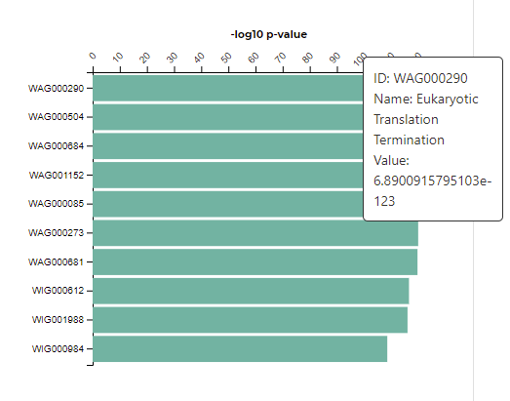
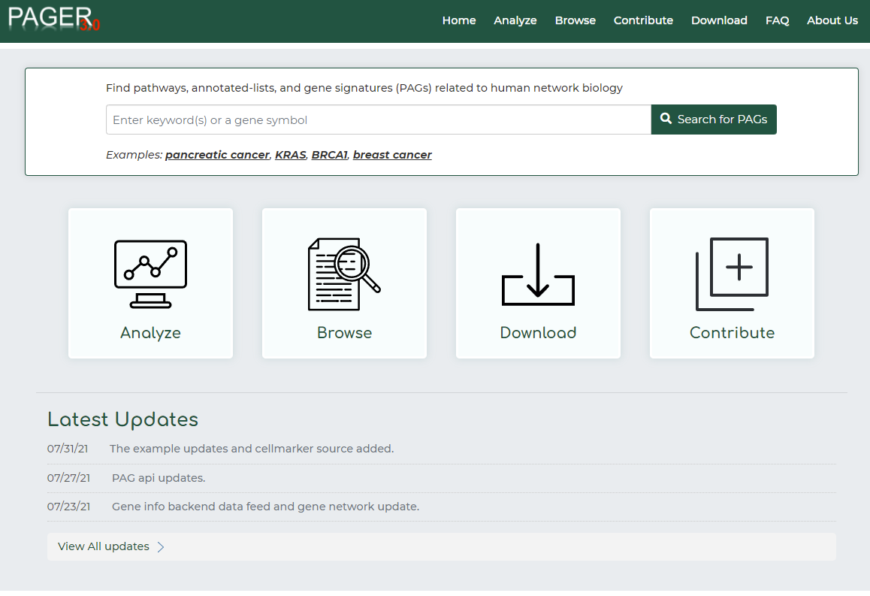
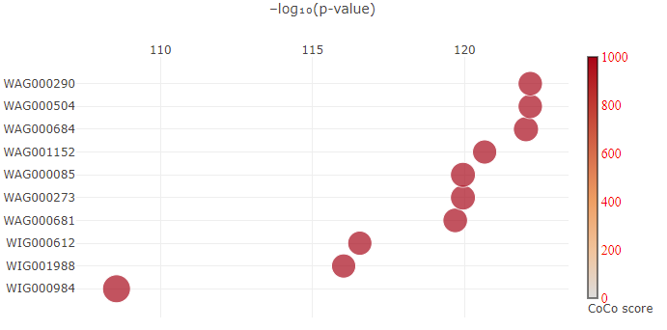
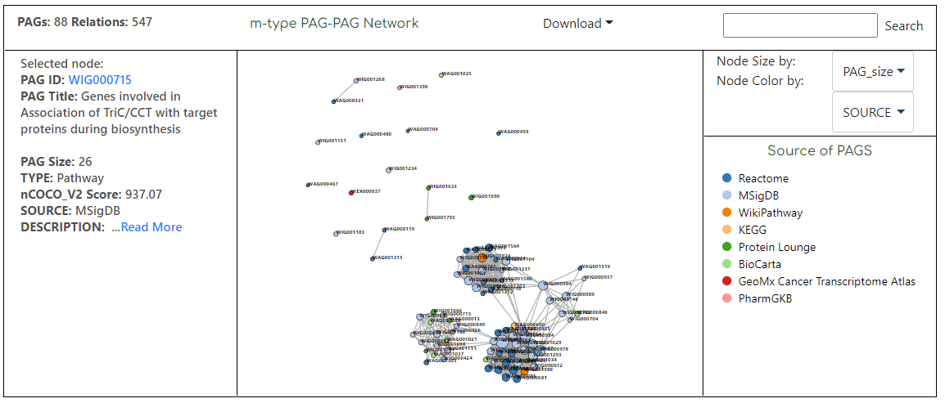
New PAGER 3.0 (http://discovery.informatics.uab.edu/PAGER/)
Yue, et al, PAGER 3.0: an update to a comprehensive database of human pathways, annotated gene lists, and gene signatures for system-scale characterization of Omics data (unpublished)
Notes:
Users go to PAGER home page (Figure 3.11) and enter searching terms such as a disease name or a gene symbol. For this use case, we entered “non small cell lung” to search for non-small cell lung cancer related gene sets. PAGER returned a list of result (Figure 3.12). The list contain genes and gene sets which relate to the searching terms. In this use case, “non small cell lung” matched with names of 160 gene sets and description of 720 gene sets. “non small cell lung” is not a name or a symbol of a gene, so PAGER returned 0 for member of gene set line. However, if users entered “BRAF”, which is a gene symbol, PAGER returned 501 gene sets which contain BRAF gene (Figure 3.13). The next step is clicking on the 160 gene sets which relate to “non small cell lung”. PAGER displayed a list of the 160 gene sets (Figure 3.14). The gene sets can be sort by name, size, organism, or data source. We filtered only gene sets whose size is between 5 and 500 and are from human. Gene sets can be added to Gene Set Box for further analysis. Checkboxes in the left most column were checked if gene sets were already in the Gene Set Box.

Slide 8
PAG data coverage in PAGER 3.0
Data Type | Data Source | Number | Type | Version
Diseases | GAD | 1671 | G | 1
 | GWAS Catalog | 1230 | G | 1
 | Phewas | 1358 | G | 2
Gene Expression Signatures | MSigDB | 8,377 | P,G | 1
 | GeneSigDB | 2942 | G | 1
 | MSigDB-ImmuneSigDB | 4852 | G | 2
Drug-Gene Interactions | PharmGKB | 102 | P | 1
 | DSigDB | 22455 | G | 2
Genes | Genome Data | 17363 | N | 1
Proteins | Protein Lounge | 388 | P | 1
 | Pfam | 1161 | A | 2
 | Isozyme | 484 | G | 2
 | HPA-normProtein | 105 | G | 3
Pathways | SPIKE | 28 | P | 1
 | WikiPathway | 144 | P | 1
 | HPD-Reactome | 528 | P | 1
 | HPD-BioCarta | 252 | P | 1
 | HPD-NCI_Nature Curated | 132 | P | 1
 | HPD-KEGG | 199 | P | 1
 | GeoMx Cancer Transcriptome Atlas | 110 | P | 3
miRNA-Gene Interactions | Microcosm Targets | 851 | G | 2
 | TargetScan | 390 | G | 2
 | mirTARbase | 2603 | G | 2
Tissue Specific Expressions | NGS Catalog | 56 | G | 1
 | GTEx | 92 | A | 2
 | HPA-TCGA | 7932 | G | 3
 | HPA-PathologyAtlas | 20 | G | 3
 | HPA-GTEx | 34 | G | 3
 | HPA-FANTOM5 | 45 | G | 3
 | HPA-normRNA | 43 | G | 3
 | HPA-RNAcon | 62 | G | 3
Functional Annotations | GOA | 21894 | A | 2
Interactome | I2D | 15874 | G | 3
Literature curated | Cell | 22 | A | 3
Cell Specific Expression | HPA-CellAtlas | 31 | G | 3
Data summary
 | PAGER3
Genes in PAGs | 27,746
Gene-Gene Relationships | 601,164
PPI | 578,587
Gene Regulation | 22,127
PAG | 113,830
singleton PAG | 33,083
multiton PAG | 80,747
with CoCo score >=1 | 74,461
PAG-PAG pairs | 42,960,619
m-type (similarity>=0.15,-logPMF>=10) | 40,753,308
r-type (-logPMF>=5) | 2,207,311

Slide 9
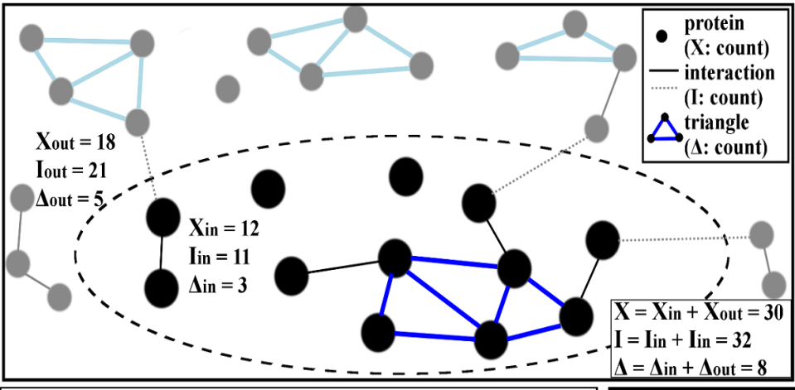
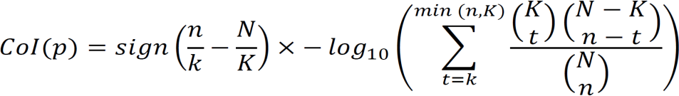
CoCo score: gauging biological relatedness of genes inside a PAG
Yue et al (2015) Bioinformatics, Vol. 31, No. 12, pp. i250-i257
CoCo (Cohesion Coefficient):
CoCo = CoI + CoT
CoI: Cohesion from enriched protein-protein interaction pairs
CoT: Cohesion from enriched protein-protein interaction triangles
The score indicates the significance test results of enriched interaction pairs (I) and enriched interaction triangles (T) within a PAG.
We calculate hypergeometric cumulative distribution function (CDF) value for CoI, e.g., using the formula:
in which N is the number of theoretical PPIs in Π, K = |I_{Π}| is the number of actual PPIs in the referenced database, n=(|PAG_i|×(|PAG_i|−1))/2n=(|PAG_i|×(|PAG_i|−1))/2 is the theoretical number of PPIs inside PAG i, and k = |I_{i}| is the number of actual PPIs inside PAG i.

Slide 10
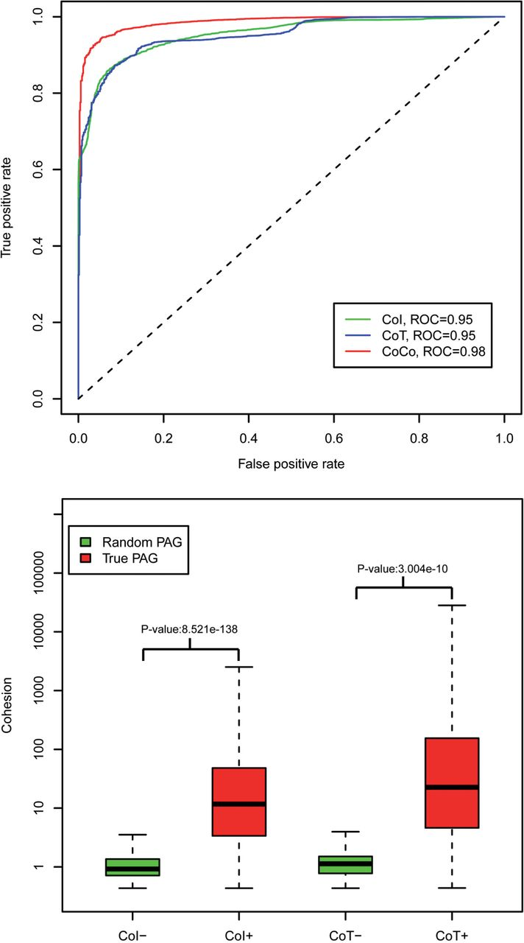
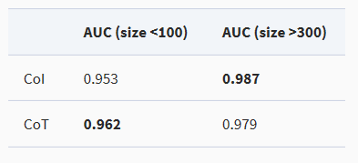
CoI or CoT as a PAG quality metric
precision
1-recall
Randomly generated PAGs are size-matched to recorded true PAGs.
CoI is better for large-sized PAGs
CoT is better for small-sized PAGs
CoCo achieves a good balance overall
Yue et al (2015) Bioinformatics, Vol. 31, No. 12, pp. i250-i257

Slide 11
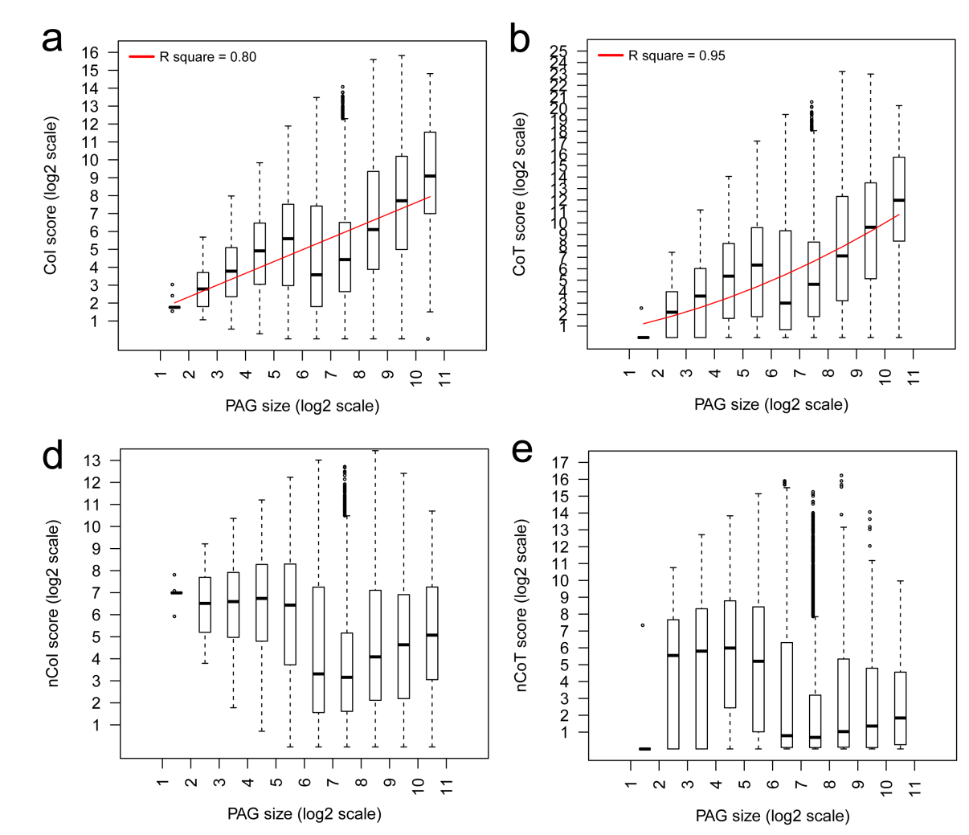
Size bias and corrections (nCoCo)
Before
An example of comparing the PAG quality using nCoCo score
PAG Id | Type | PAG name | PAG size | Theoretical PPI | PPI | CoCo | nCoCo
WIG001980 | P | Non-homologous end joining | 6 | 15 | 13 | 88 | 1153
WIG001424 | P | Actin Nucleation and Branching | 101 | 5050 | 612 | 2094 | 130
After
CoI and CoT normalization. (a) The relationship of PAG size and CoI score, (b) the relationship of PAG size and nCoI score, (d) the relationship of PAG size and nCoT score, (e) the CoI, CoT, CoCo score distribution of PAGER
Yue, et al, Nucleic Acids Research, Volume 46, Issue D1, 4 January 2018

Slide 12
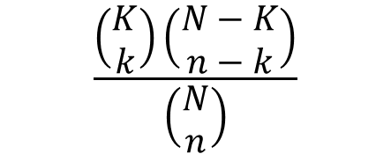
Defining PAG-to-PAG relationships co-membership based PAG-to-PAG relationship (m-type)
PAG Co-membership networks connect PAGs if there is a significant number of shared genes between the two PAGs.
Hypergeometric distribution
N is the total number of genes
n is the number of genes in gene set A
K is the number of genes in gene set B
k is the number of shared genes
Control false discovery rate using BH procedure (q-value = 0.05)
B
A
k
$$\frac{\left(\begin{matrix}K \\ k\end{matrix}\right)\left(\begin{matrix}N−K \\ n−k\end{matrix}\right)}{\left(\begin{matrix}N \\ n\end{matrix}\right)}$$
A
B
k successes in n draws without replacement from a finite population of size N containing a maximum of successes K
Yue et al (2015) Bioinformatics, Vol. 31, No. 12, pp. i250-i257

Slide 13
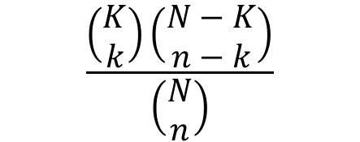
Constructing Regulatory PAG relationships
Regulatory PAGs are constructed from PAG A to PAG B if there is a significant number of gene regulations from the unique genes of A to B.
Hypergeometric distribution
N is the total number of gene regulations
n is the number of gene regulations where genes in A regulate genes outside A
K is the number of gene regulations where genes in B are regulated from genes outside B
k is the number of gene regulations from (not shared) genes in A to B
Control false discovery rate using BH procedure (q-value = 0.05)
$$\frac{\left(\begin{matrix}K \\ k\end{matrix}\right)\left(\begin{matrix}N−K \\ n−k\end{matrix}\right)}{\left(\begin{matrix}N \\ n\end{matrix}\right)}$$
A
B
A
B
k successes in n draws without replacement from a finite population of size N containing a maximum of successes K
Yue et al (2015) Bioinformatics, Vol. 31, No. 12, pp. i250-i257

Slide 14
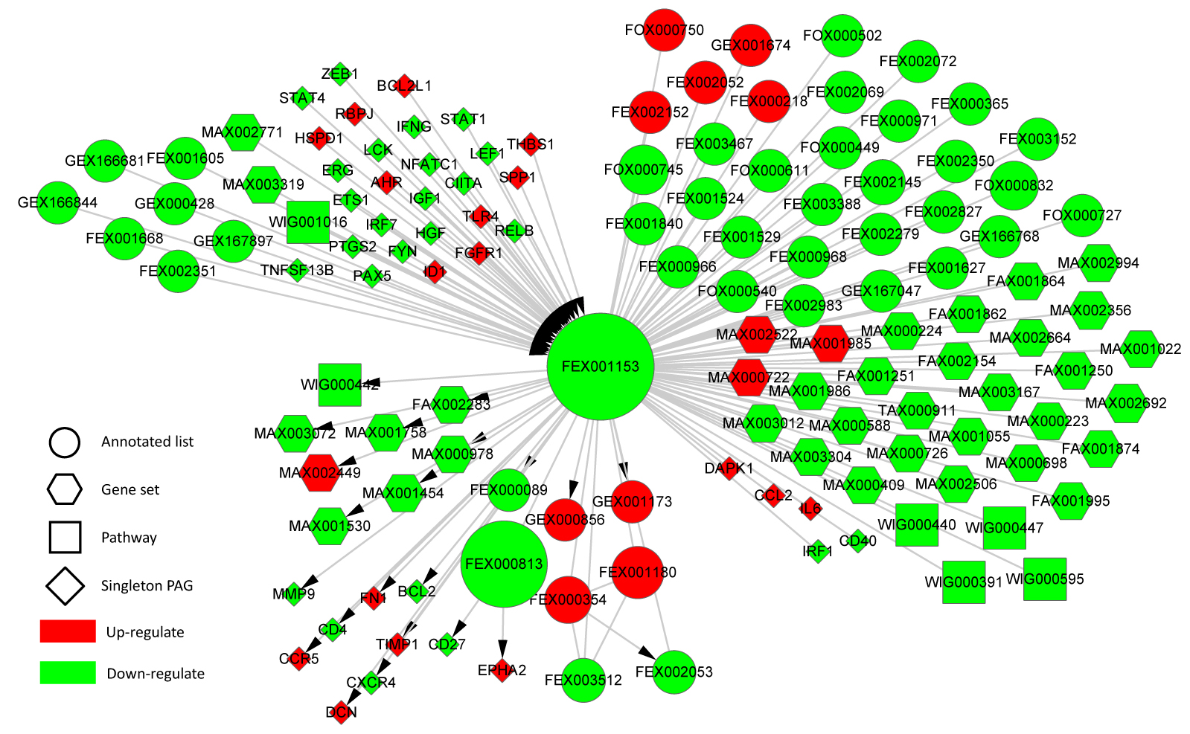
Myeloid-derived suppressor cell (MDSC) Regulatory PAG-PAG Network Reveals Key Immunity Impacts
A large (n=4568) PAG containing genes responsible for immunity functions
Upstream of the immunity-suppressed process are many activated cell growth and differentiation signal molecules
Downstream of the immunity-suppressed process are many processes responsible for cell differentiation (e.g., FEX00813) and cancer progression (e.g., FEX002152 and EPHA2), and chemokine signaling (e.g., CCR5). GEX001173
Yue et al (2015) Bioinformatics, Vol. 31, No. 12, pp. i250-i257
Notes:
Myeloid-derived suppressor cell (MDSC) microarray data analysis between tumor and normal control conditions
tumor MDSC at the peritoneal cavity (T0) and compared control MDSC at the spleen (N0) of inflamed mice
1,105 differentially expressed genes (N0), which includes 576 over-expressed genes (N+) and 529 under-expressed genes (N-) using pmf < 0.05 as the filter and the minimum log fold-change of 2.5 to select

Slide 15
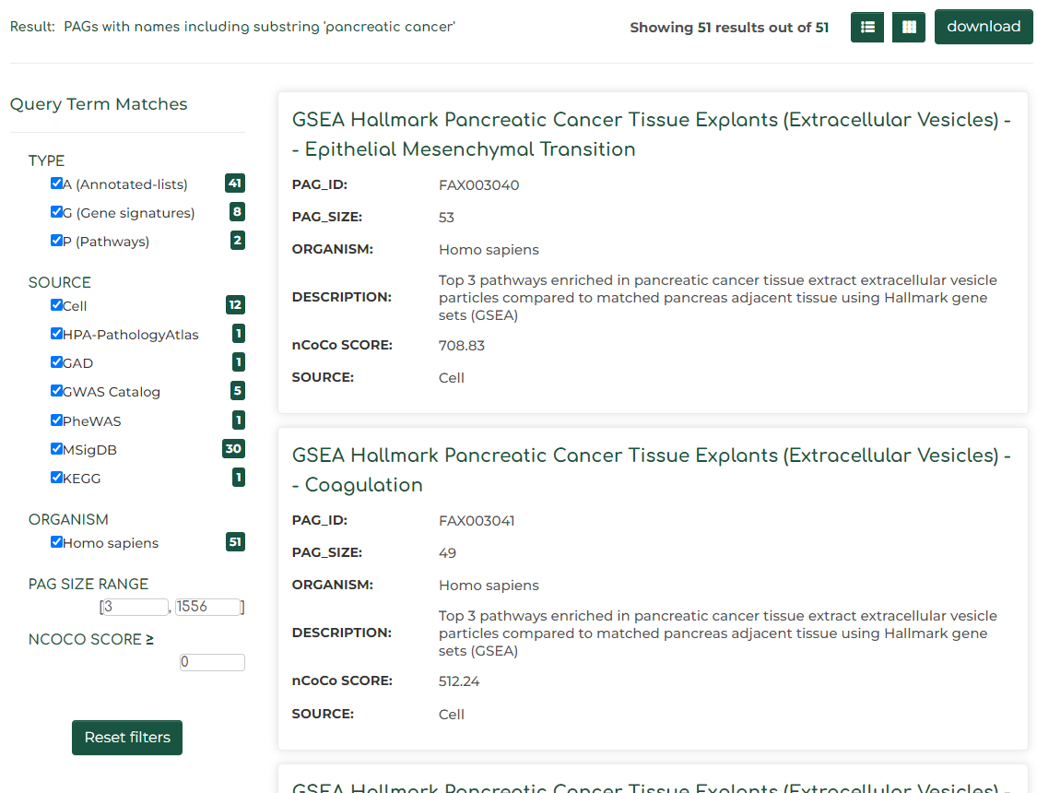
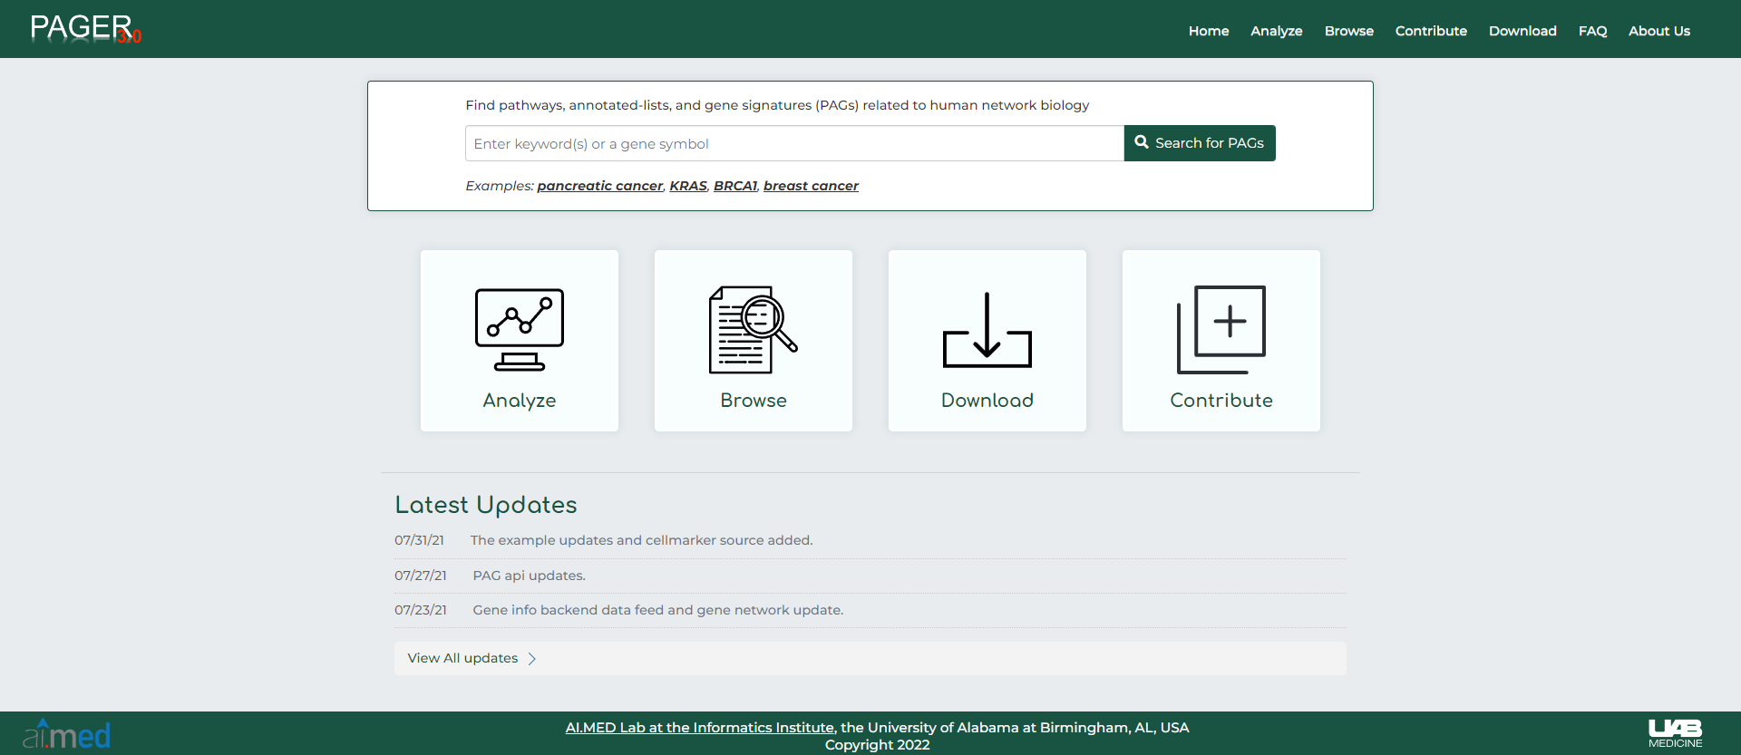
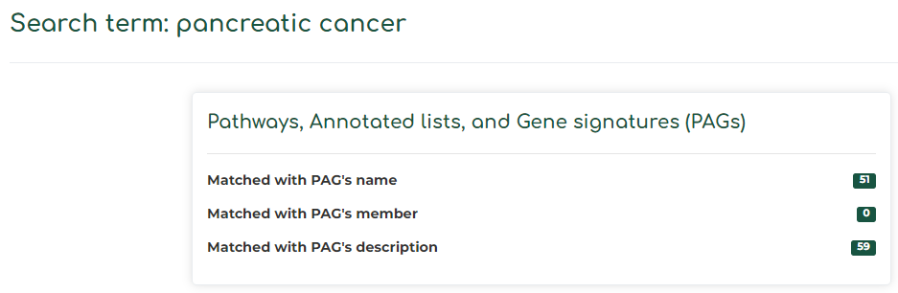
Demo
Basic search: Retrieve PAGs using keywords, e.g., the pancreatic cancer related PAGs
C
1
A
3
2
B

Slide 16
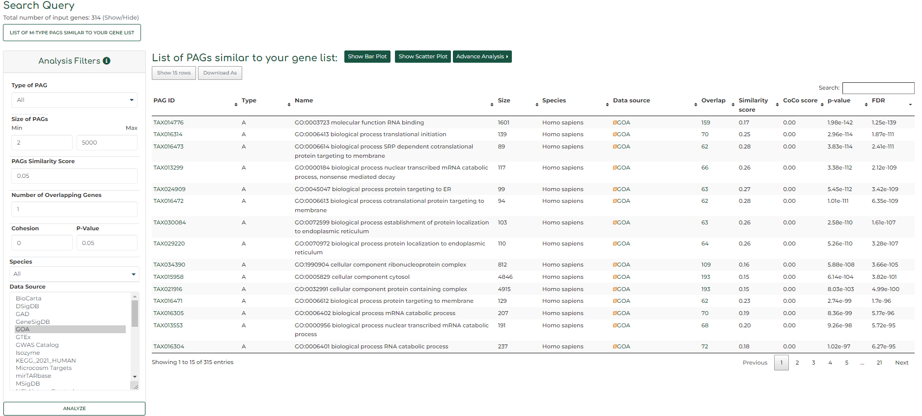
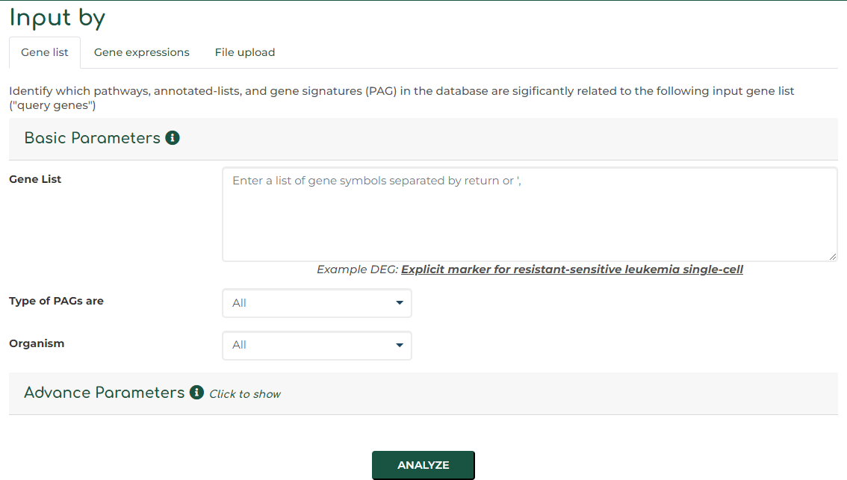
Demo
Analysis: Retrieve PAGs using list of genes
C
1
2
B
A
1
2

Slide 17
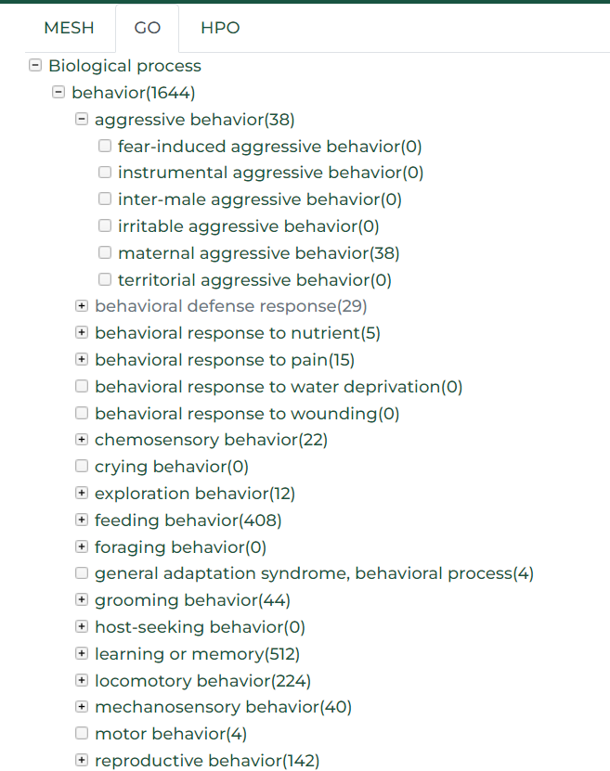
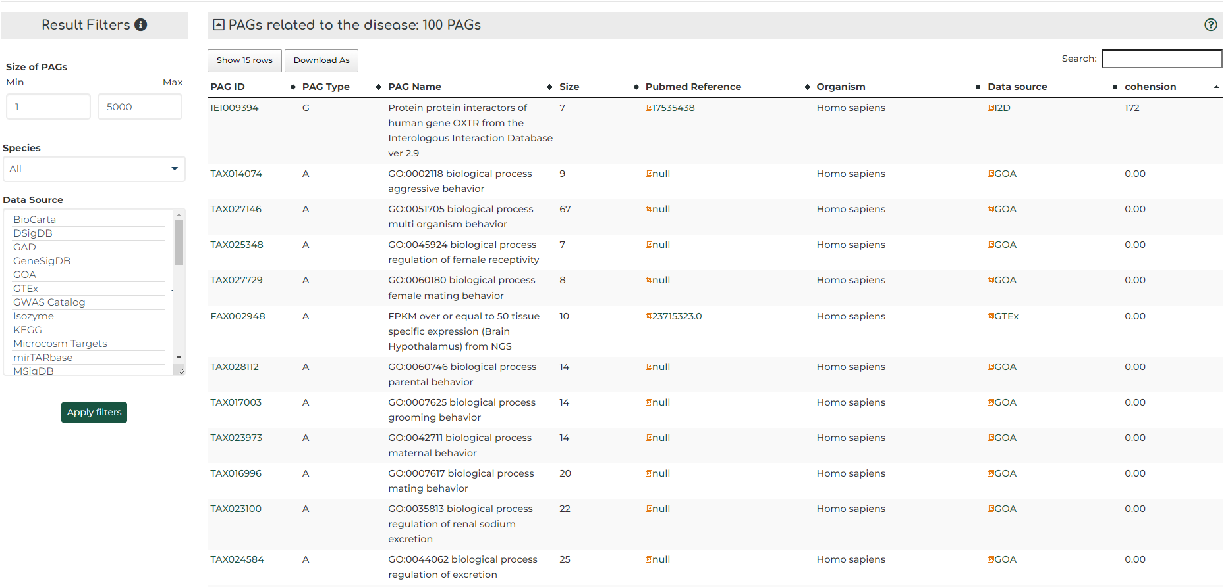
Demo
Browse: knowledge-based search
C
B
A
1
2

Slide 18
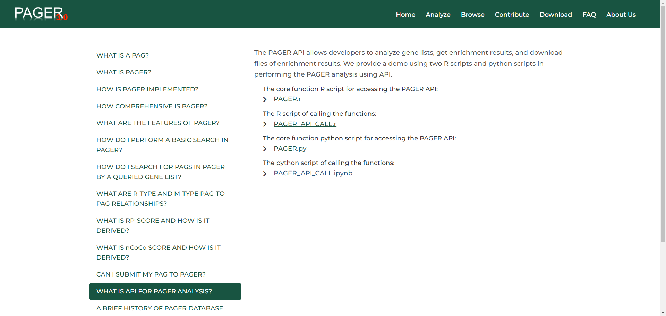
Demo
API example http://discovery.informatics.uab.edu/PAGER/index.php/pages/help

Slide 19
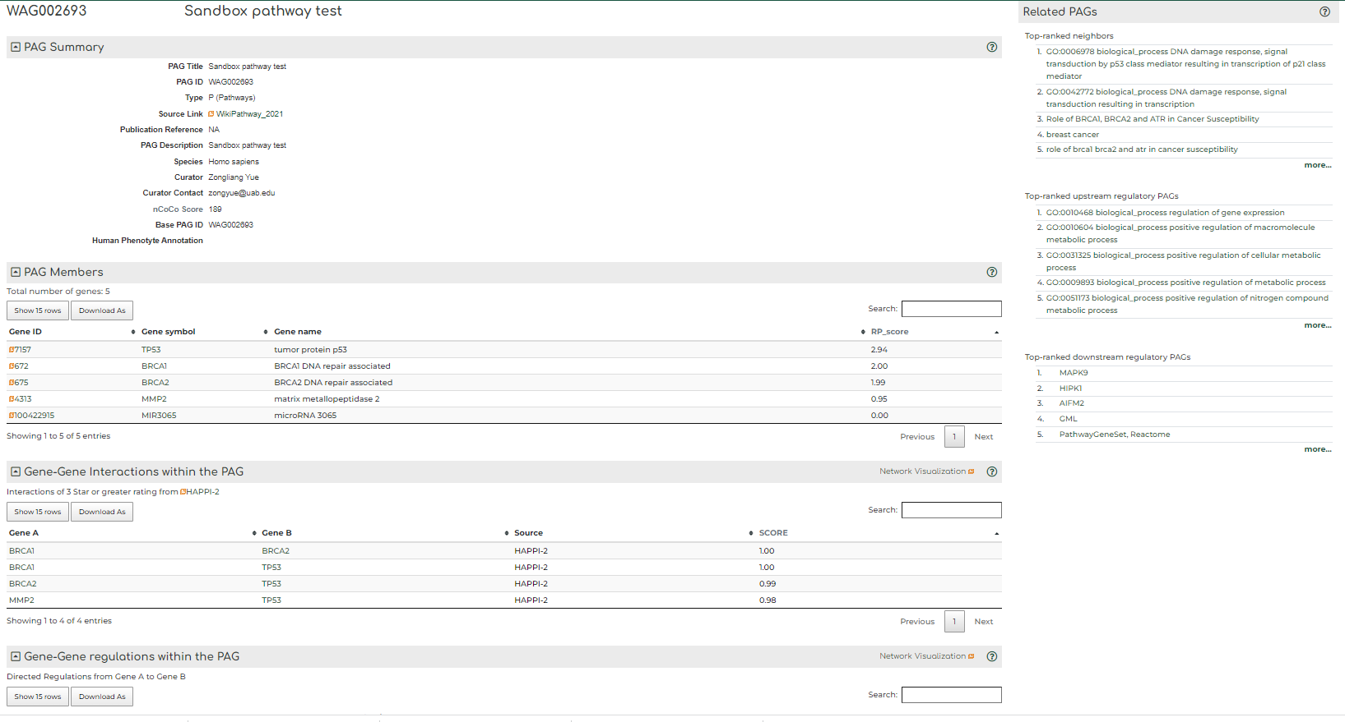
Demo
PAG details: http://discovery.informatics.uab.edu/PAGER/index.php/geneset/view/[PAG_ID]
1
3
2

Slide 20

Demo
Full text of our publication and how to cite us

Slide 21



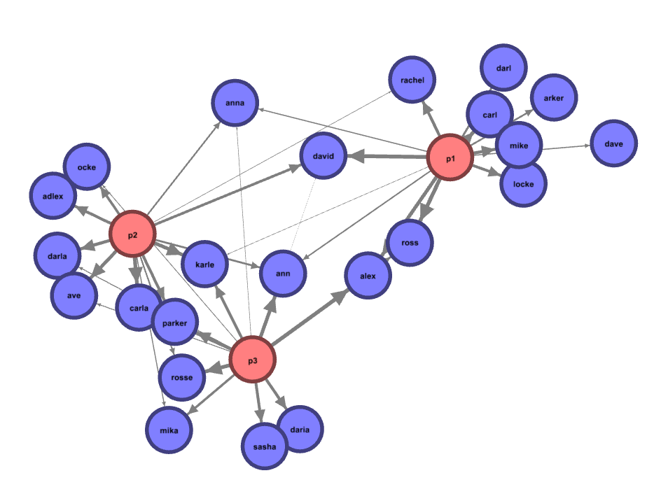
PAGER web app
An interactive online application to perform the gene set enrichment analysis and network interpretation of the functional genomics result
Features:
Online data analytics: https://aimed-lab.shinyapps.io/PAGERwebapp/
Bundled with UALCAN TCGA data sets (http://ualcan.path.uab.edu/).
Interactive visualization apps for biological network analysis.
Underlying Technology:
Network Visualization

Slide 22
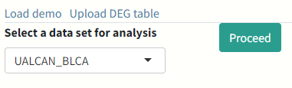
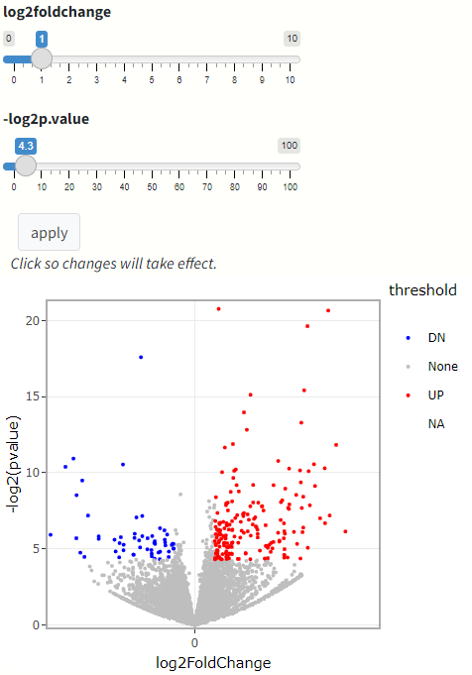
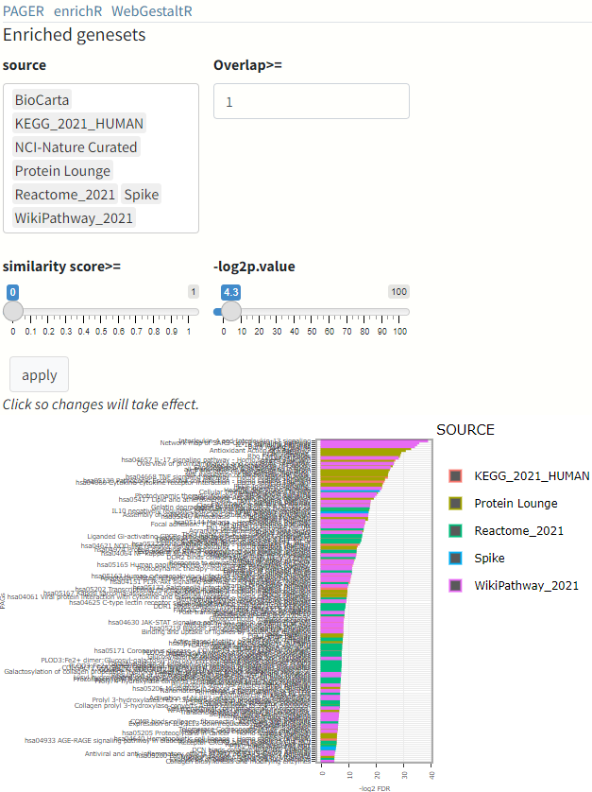
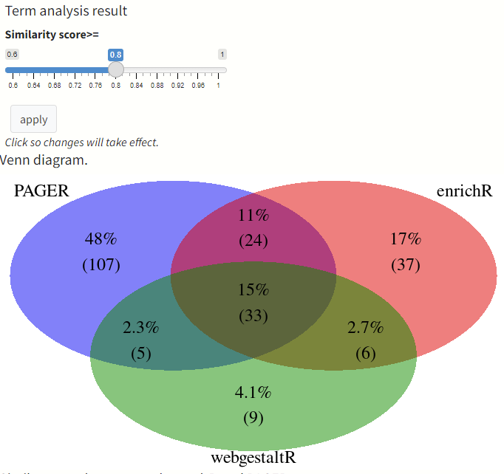
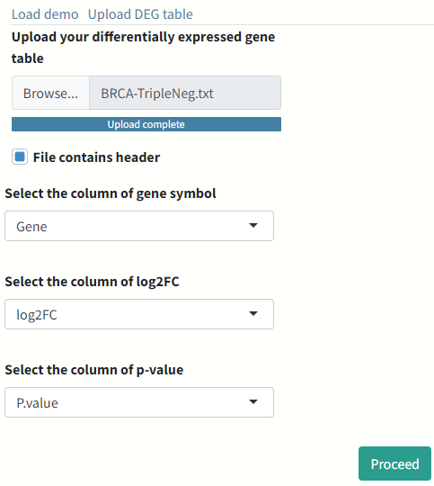
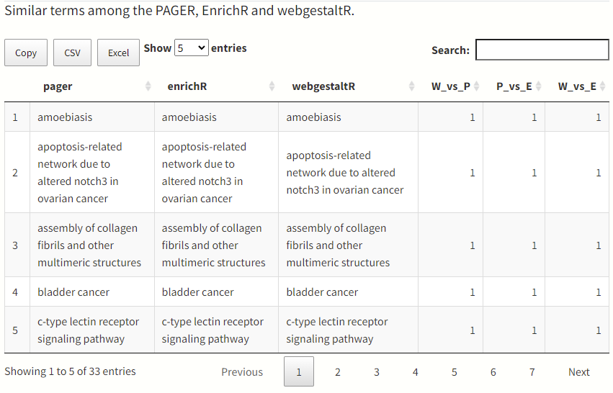
PAGER web app workflow
Load
Filter
Enrich
Compare
https://aimed-lab.shinyapps.io/PAGERwebapp/

Slide 23
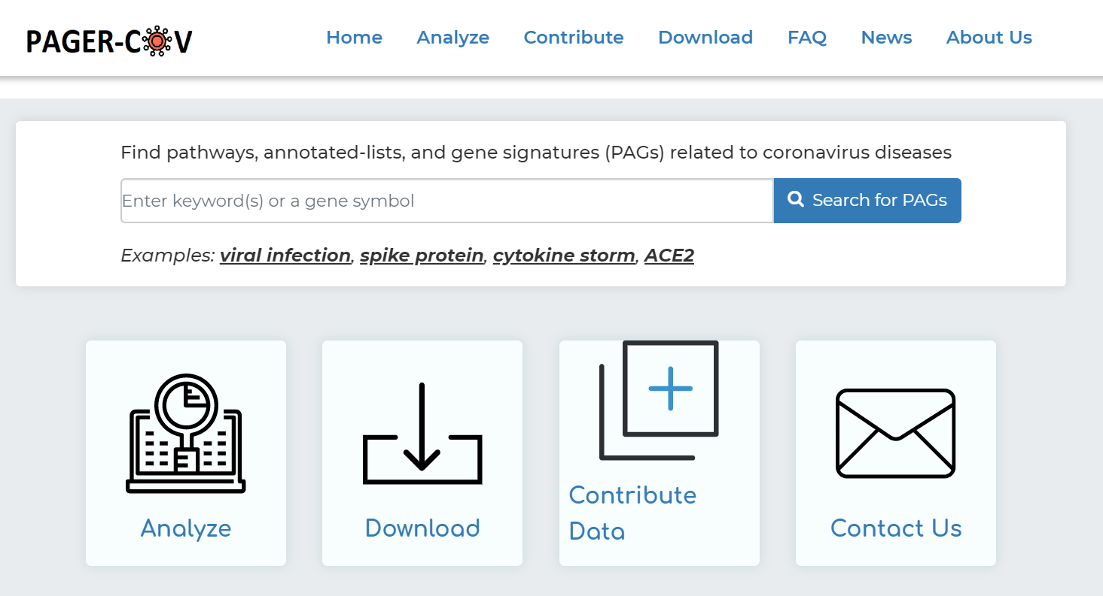
http://discovery.informatics.uab.edu/PAGER-COV/
33 data sources
11,835 PAGs (pathways, annotated gene lists, and gene signatures)
19,996,993 PAG-to-PAG relationships stored in the database
Yue et al Nucleic Acids Research, Vol. 49 (D1), 2021, pp D589-D599, doi.org/10.1093/nar/gkaa1094

Slide 24
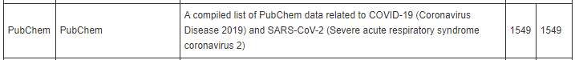
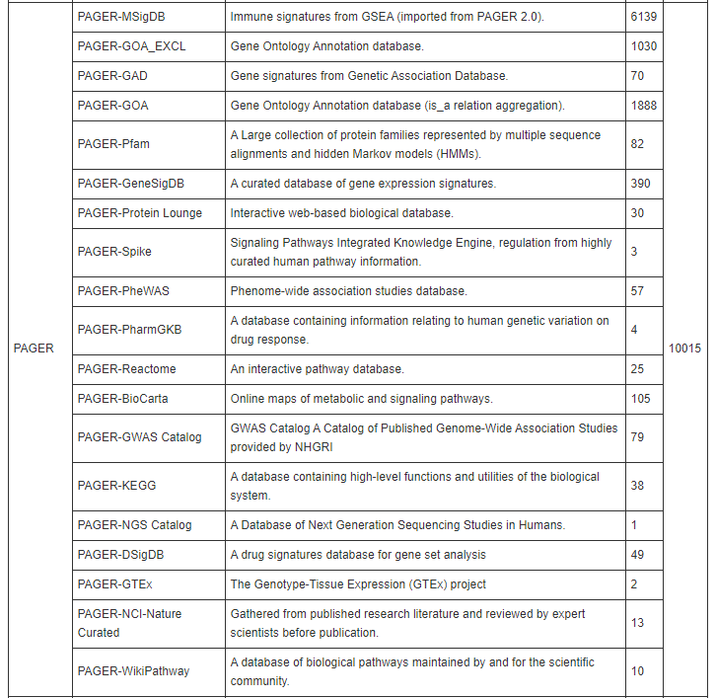
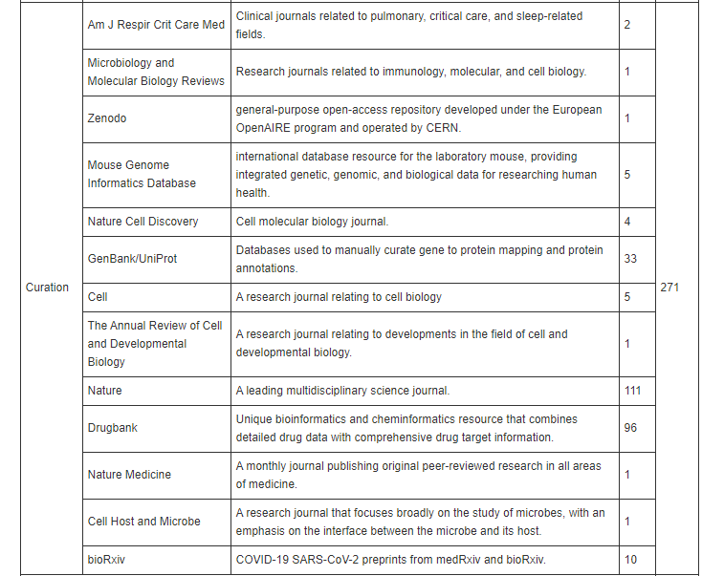
PAGER-CoV data source: immune response related PubMed, PubChem, and related functional databases
1549 repositioning targets
271 curated SARS-CoV-2 gene set
10015 immune response gene signatures
Yue et al Nucleic Acids Research, Vol. 49 (D1), 2021, pp D589-D599, doi.org/10.1093/nar/gkaa1094

Slide 25


PAGER-CoV-Run
A web-based python-scripted interactive tool for COVID-19 SARS-CoV-2 functional genomic and downstream analysis
Features:
Online data analytics: https://pager-cov-run.herokuapp.com/
Bundled with example COVID-19 functional genomic data sets (GEO database).
Interactive visualization apps for biological network analysis.
Underlying Technology:
Tutorial video: https://youtu.be/AArN4zdG94E
Network Visualization
Notes:
Gene Expression Omnibus (GEO) repository

Slide 26
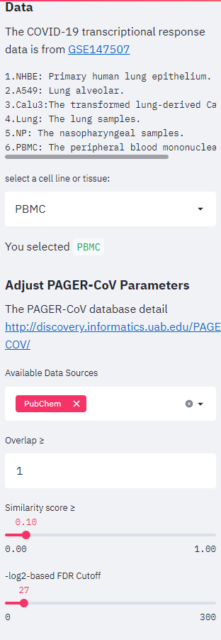
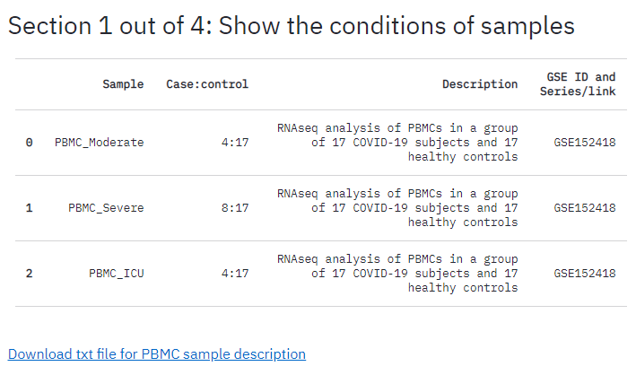
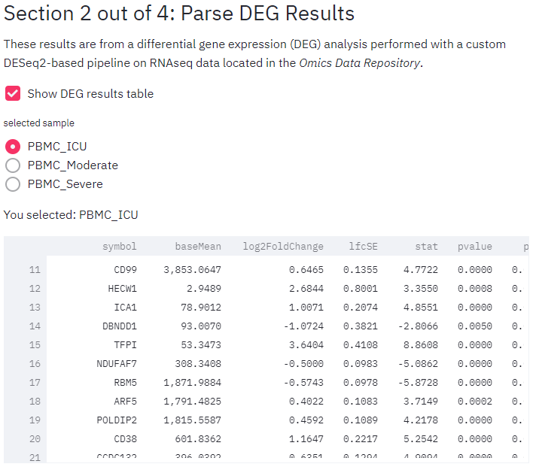
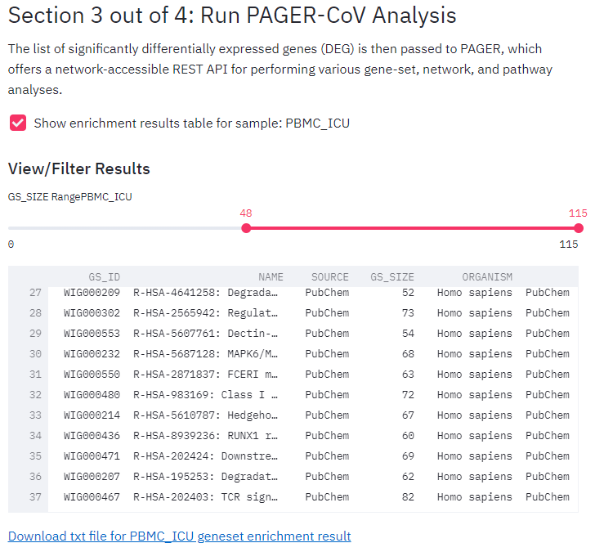
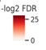
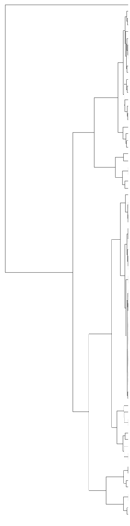
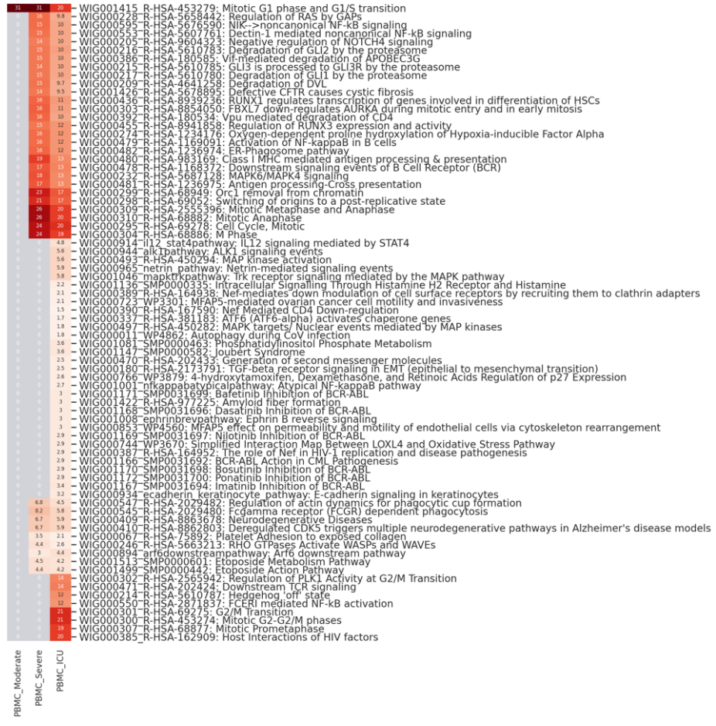
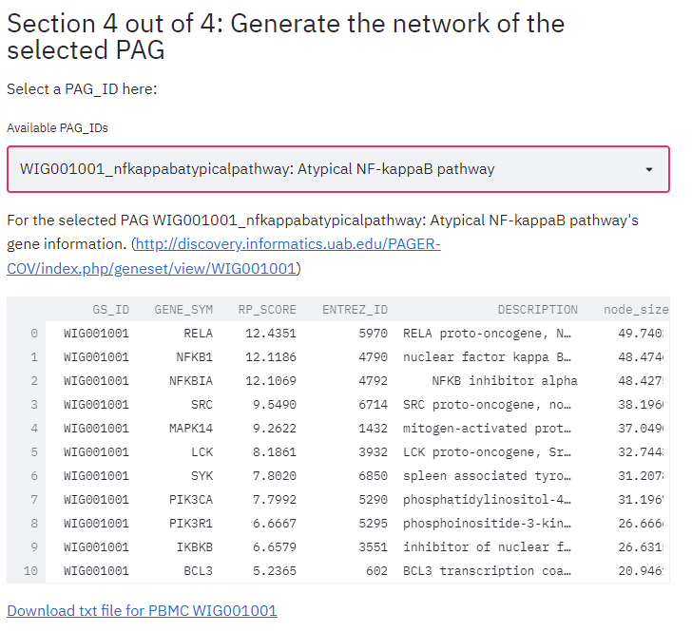
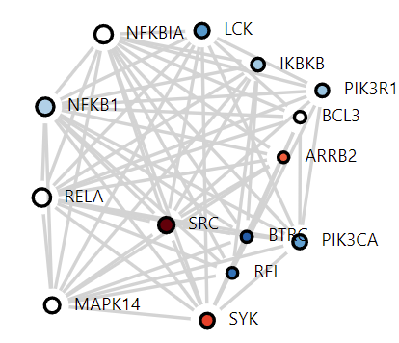
PAGER-CoV_Run user interface
https://youtu.be/AArN4zdG94E
UI in PAGER-CoV_Run

Slide 27





Case study: Peripheral blood samples from ICU, severe, and moderate enriched pathway comparison
moderate
severe
ICU
Ranked genes in “Atypical NF-kappaB pathway”
GENE_SYM | RP_SCORE | ENTREZ_ID | DESCRIPTION
RELA | 12.44 | 5970 | RELA proto-oncogene, NF-kB subunit
NFKB1 | 12.12 | 4790 | nuclear factor kappa B subunit 1
NFKBIA | 12.11 | 4792 | NFKB inhibitor alpha
SRC | 9.55 | 6714 | SRC proto-oncogene, non-receptor tyrosine kinase
MAPK14 | 9.26 | 1432 | mitogen-activated protein kinase 14
LCK | 8.19 | 3932 | LCK proto-oncogene, Src family tyrosine kinase
SYK | 7.80 | 6850 | spleen associated tyrosine kinase
PIK3CA | 7.80 | 5290 | phosphatidylinositol-4,5-bisphosphate 3-kinase catalytic subunit alpha
PIK3R1 | 6.67 | 5295 | phosphoinositide-3-kinase regulatory subunit 1
IKBKB | 6.66 | 3551 | inhibitor of nuclear factor kappa B kinase subunit beta
BCL3 | 5.24 | 602 | BCL3 transcription coactivator
BTRC | 4.91 | 8945 | beta-transducin repeat containing E3 ubiquitin protein ligase
REL | 4.71 | 5966 | REL proto-oncogene, NF-kB subunit
ARRB2 | 4.53 | 409 | arrestin beta 2
Notes:
629 samples​
6 cell types​
-primary human lung epithelium (NHBE)​
-lung alveolar (A549 cell line) ​
-the transformed lung-derived Calu-3 cells (Calu3)​
-peripheral blood mononuclear cells​
-leukocytes​
-Human induced pluripotent stem cell-derived cardiomyocytes​
4 tissues​ -lung​
-liver organoid​
-pancreatic organoid​
-nasopharyngeal

Slide 28




References
PAGER-3 webserver: http://discovery.informatics.uab.edu/PAGER/
PAGER-web-app Demo: https://aimed-lab.shinyapps.io/PAGERwebapp/
PAGER-CoV webserver: http://discovery.informatics.uab.edu/PAGER-COV/
PAGER-CoV-Run Source code: https://github.com/aimed-uab/PAGER-COV_RUN
PAGER-CoV-Run Demo: https://pager-cov-run.herokuapp.com/
YouTube Tutorial: https://youtu.be/AArN4zdG94E
U54TR002731
U01CA223976
R01AI134023
R01AR073850

